Slide 1

GUPSHUP
// May 2021
Discussion Forum
How to start using Gupshup?
Sign up…

Slide 2
Kashish Harisinghani
1911016
Harshit Jain
1911017
Rushabh Gandhi
1911012

Slide 3

Contents
Problem Definition
Objective
Literature survey
Architecture diagram
Functionalities
Implementation details
UI designs
Future Scope

Slide 4

PROBLEM DEFINITION
Making a discussion forum for an institute where students and teachers can ask, and answer any of the questions asked by other members of the institute, also having some possibility to form a community of liked-minded people so that the questions can be answered according to the area of interest.

Slide 5

OBJECTIVE
Generally a college or an institute does not have a place where the students as well as the faculty can come together and can discuss ideas and thoughts. Sometimes the problems can be just solved by mere discussion with someone but the lack of resources, guidance, knowledge and a suitable platform hinders this process of sharing and learning. This website aims to provide a solution for the given problem in an efficient and accurate method.

Slide 6
DELIVERABLES
Python executable code
Project Report
Readme file
User Manual
user guide video
List of features
Html/CSS/JS code files
Project presentation

Slide 7
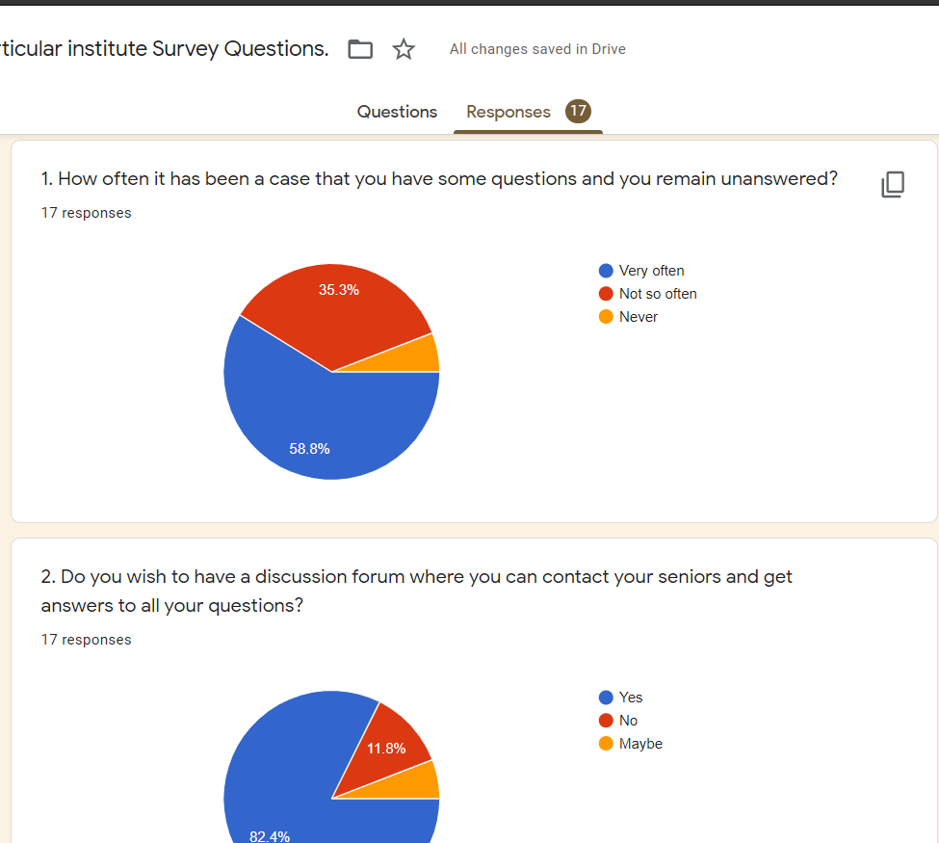
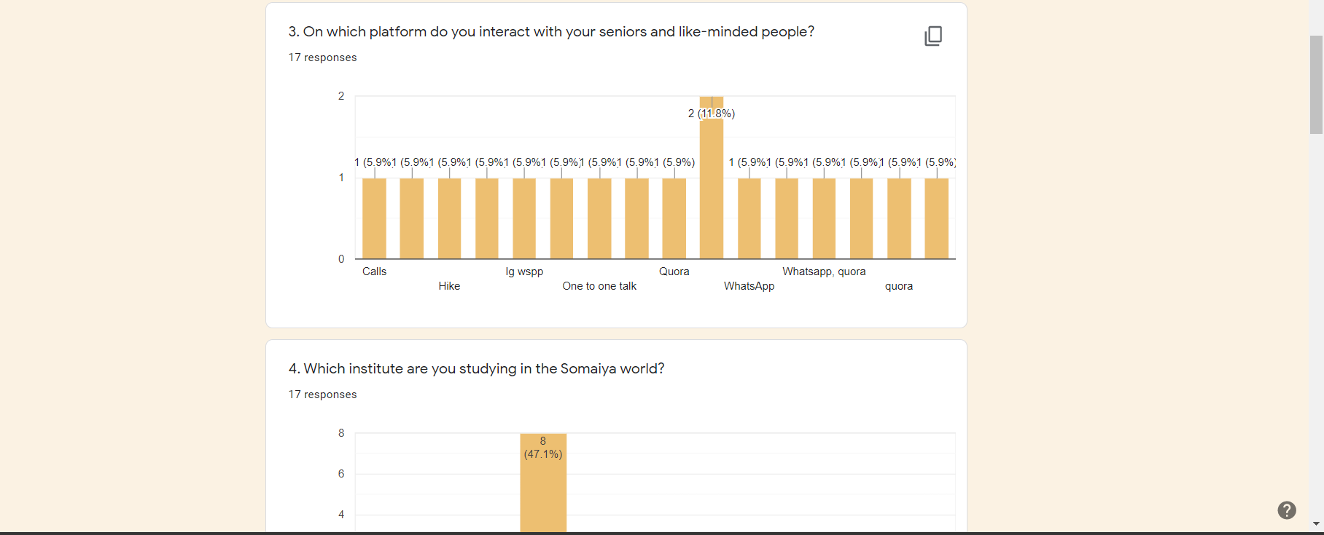
Literature Review
Link to Google Form

Slide 8
Statistics From Survey
63.3%
81.8%
45.5%
Unanswered
Need
Like
Questions remain unanswered
Needed Discussion forum
Like to read and write blogs related to college life

Slide 9
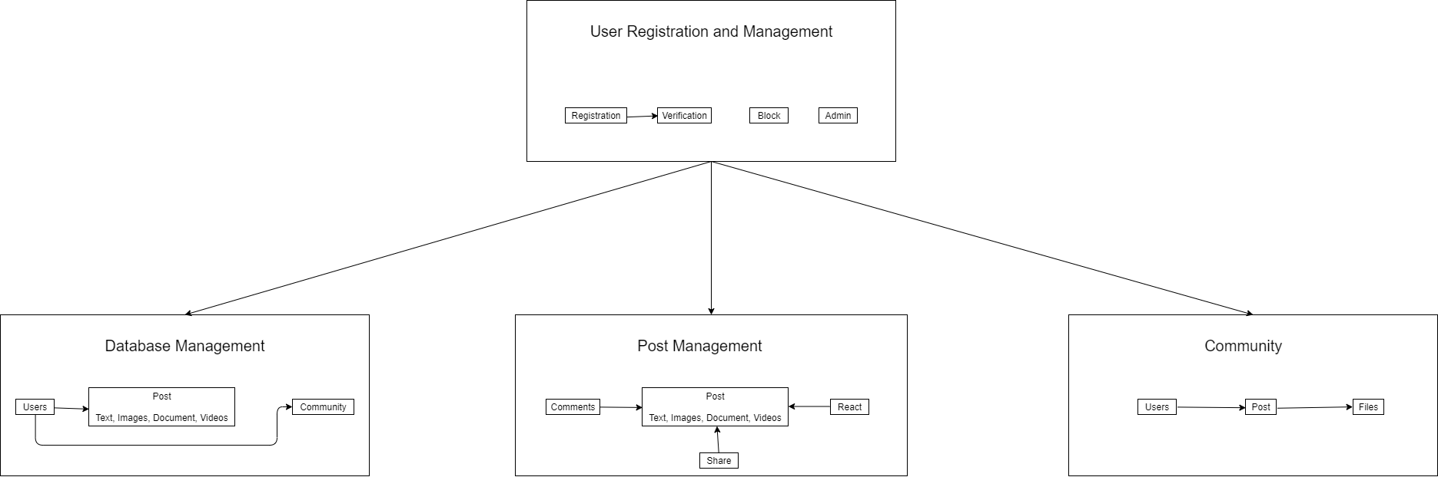
Architecture Diagram

Slide 10

Outline of implementation
User App
Chat App
UI Templates
Post App
Still more to come

Slide 11

FUNCTIONALITIES

Slide 12

Functionalities
Login into the web portal using a unique id.
Adding blogs to the website.
Question answer-based forum.
Writing comments for other posts.
Answering a question.
Upvote and downvote
Segregating the posts based on different categories.
Live Chat feature
Responsiveness
Bookmark functionality.

Slide 13
Implemented Functionalities
Login into the web portal using a unique id.
Adding blogs to the website.
Question answer-based forum.
Writing comments for other posts.
Answering a question.
Upvote and downvote
Segregating the posts based on different categories.
The website is completely responsive.
Live Chat Feature for community.
Bookmark Facility
Sharing of Posts
Upvote Downvote for Post answers/comments

Slide 14
Implementation of suggestions given by faculties
Live Chat Feature for community.
Bookmark Facility
Sharing of Posts

Slide 15
IMPLEMENTATION DETAILS

Slide 16
Post App
Laid the pipeline of the app in urls.py.
Made class based and function based views in views.py.
Worked on UI templates.
Developed forms for new posts in forms.py.
Established entities and fields for post app in models.py.

Slide 17
User App
Added user authentication functionalities.
Laid the pipeline of the app in urls.py.
Made class based and function based views in views.py.
Worked on UI templates.
Developed forms for new posts in forms.py.
Utilized signals for updating profile.
Established entities and fields for post app in models.py.

Slide 18
Integration of the Apps
Both apps could not run individually and needed to be fused together for a rich UI experience. Hence we took help of Django documentation and various sites like the medium and stackoverflow to achieve the amalgamation of both the apps.

Slide 19

AN IMAGE IS WORTH A THOUSAND WORDS

Slide 20
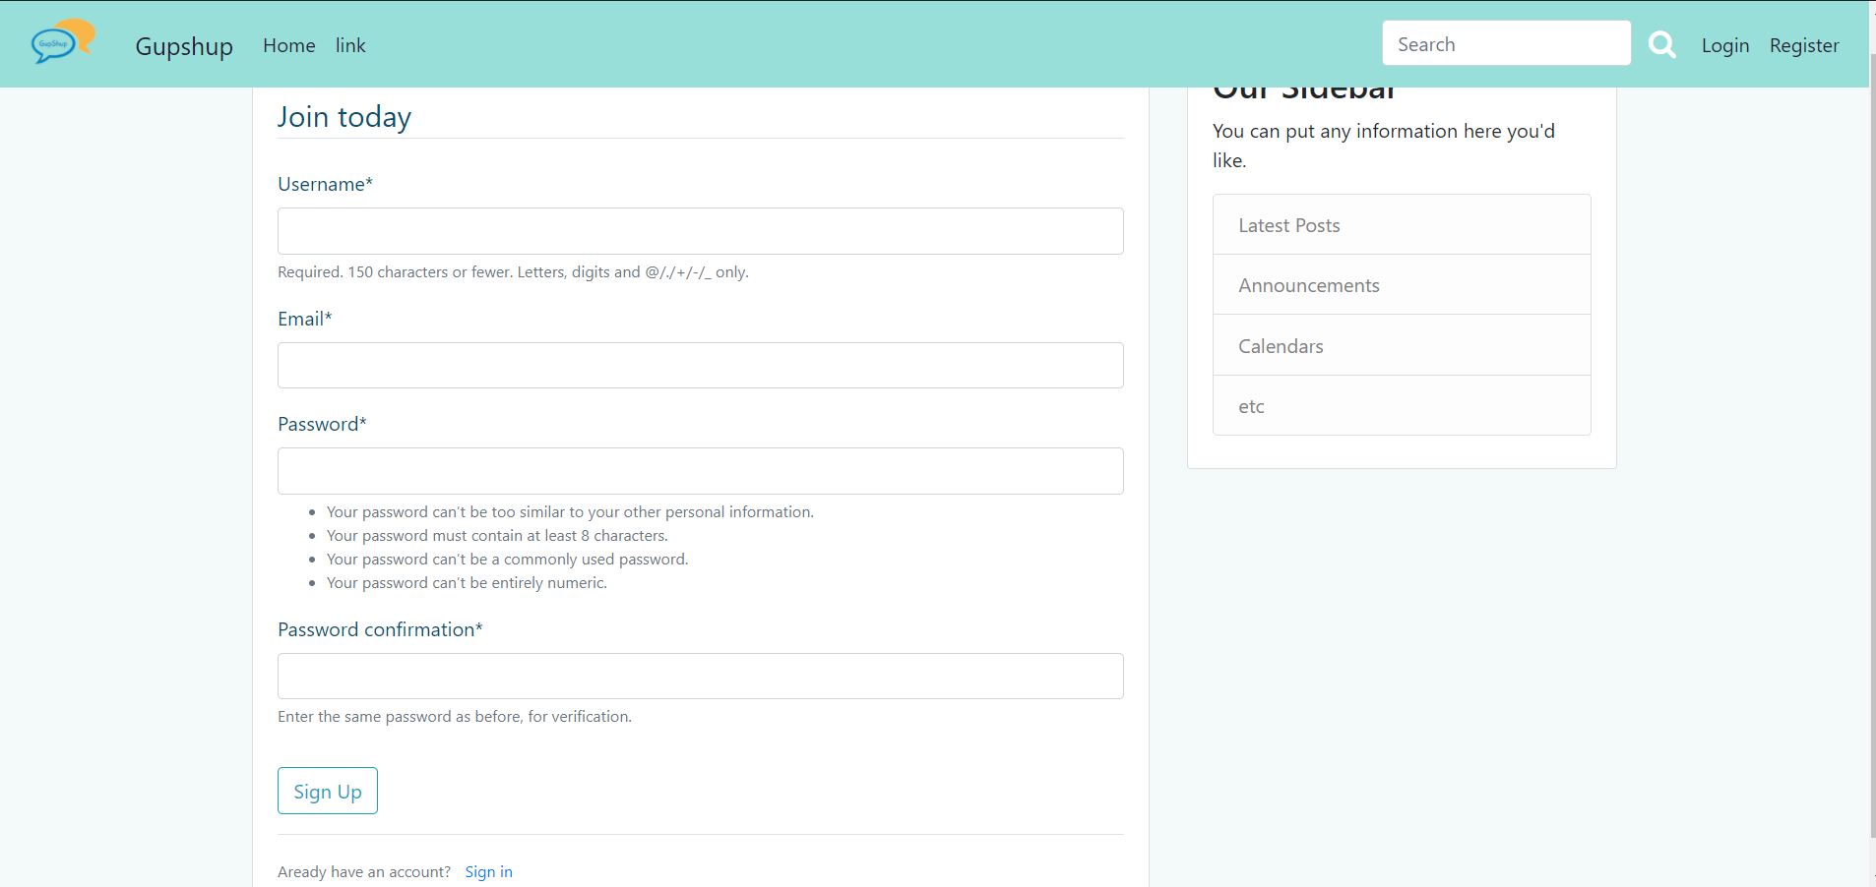
01. Login and Register

Slide 21
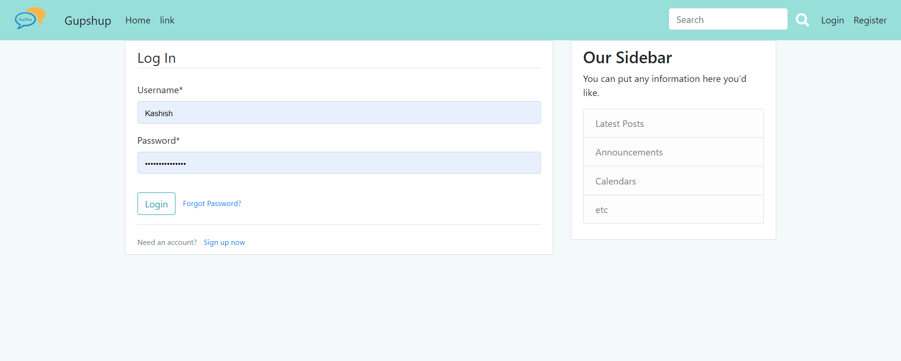
02. Login

Slide 22
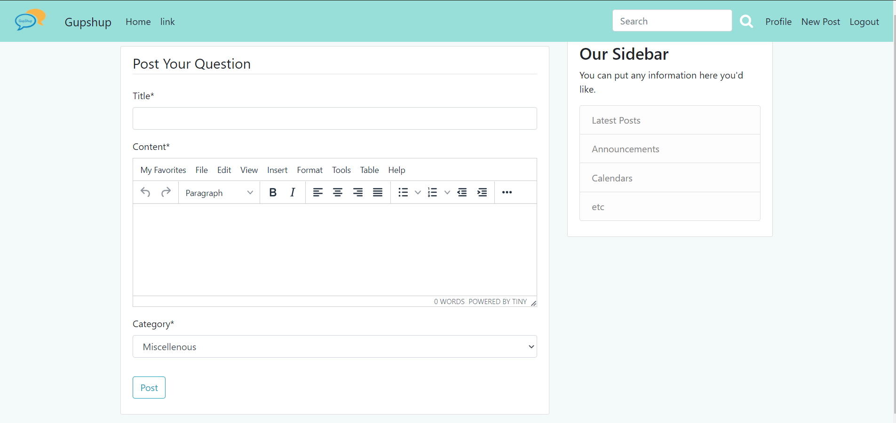
03. New Post

Slide 23
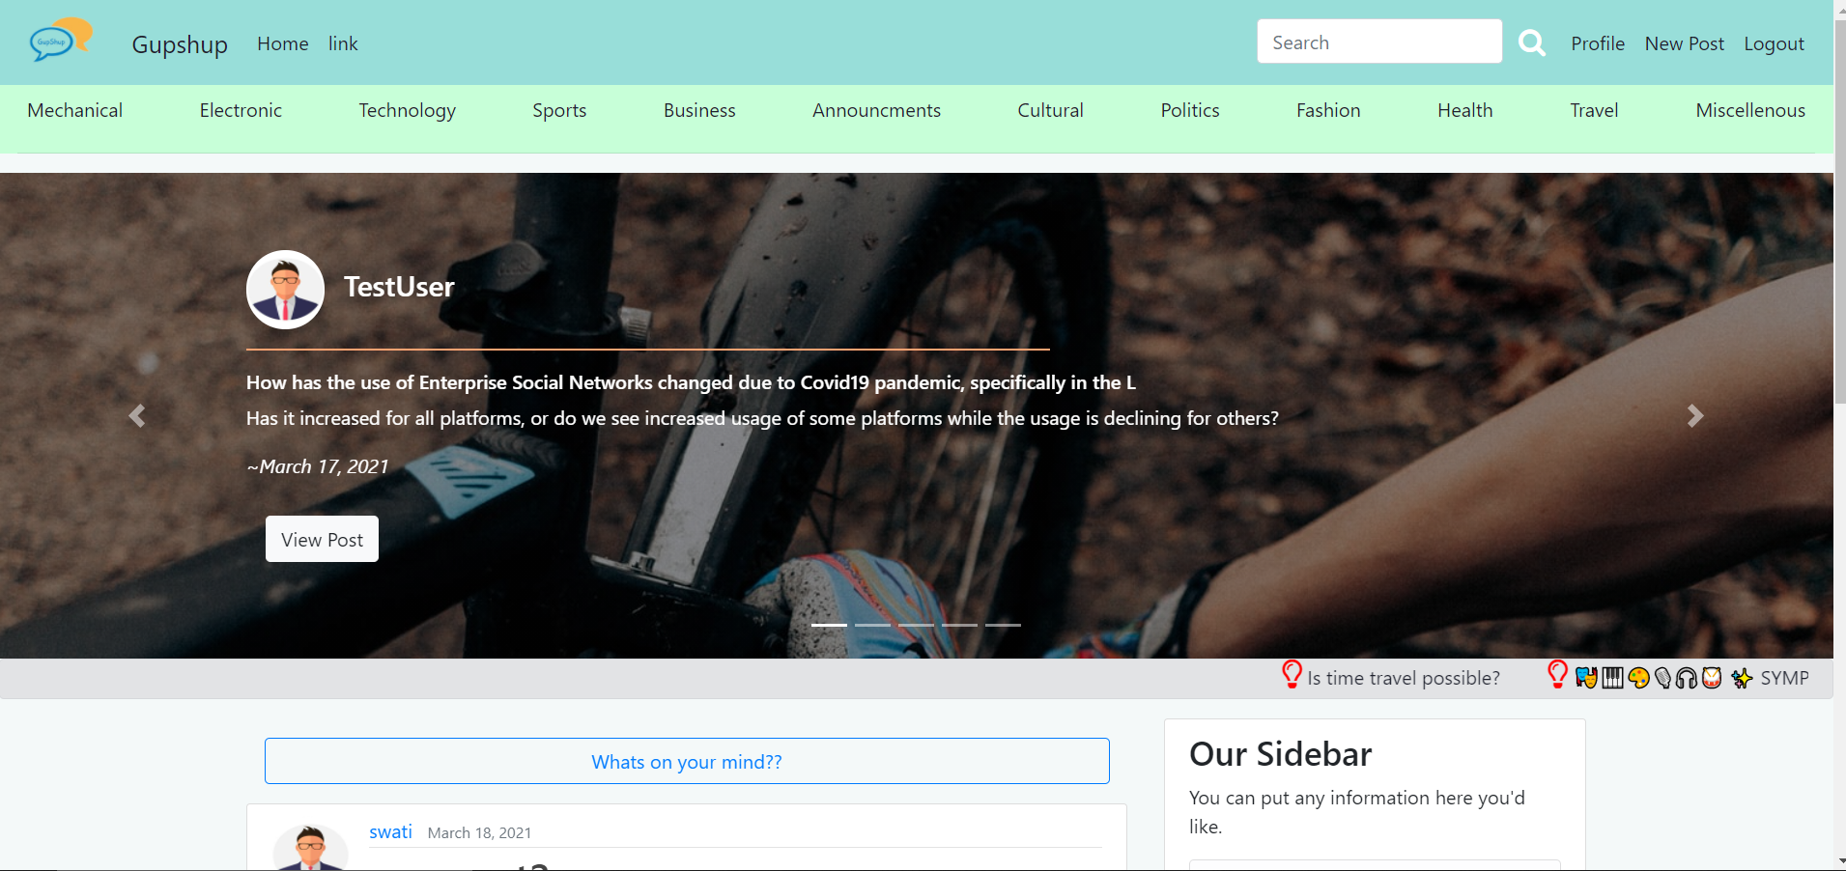
04. Landing(1)

Slide 24
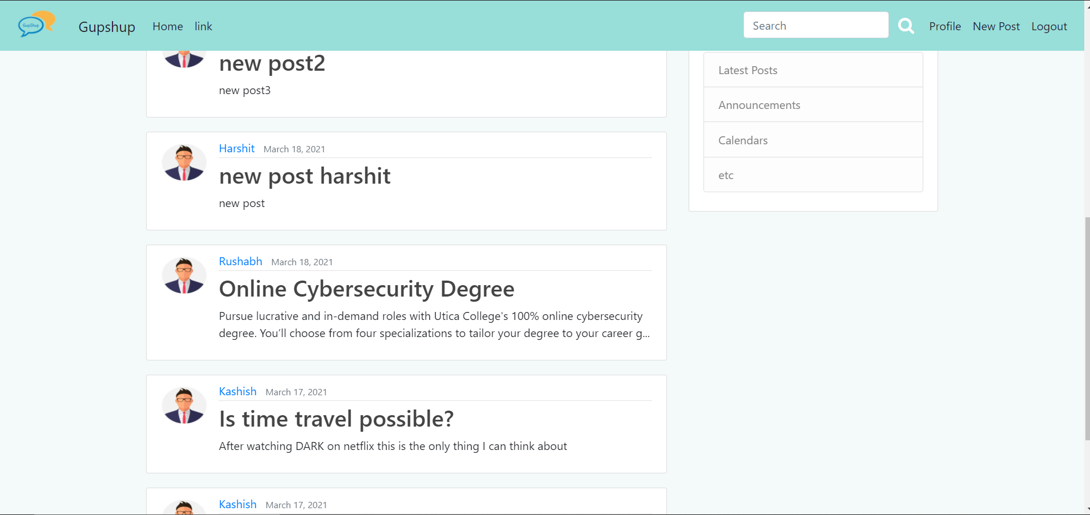
04. Landing(2)

Slide 25
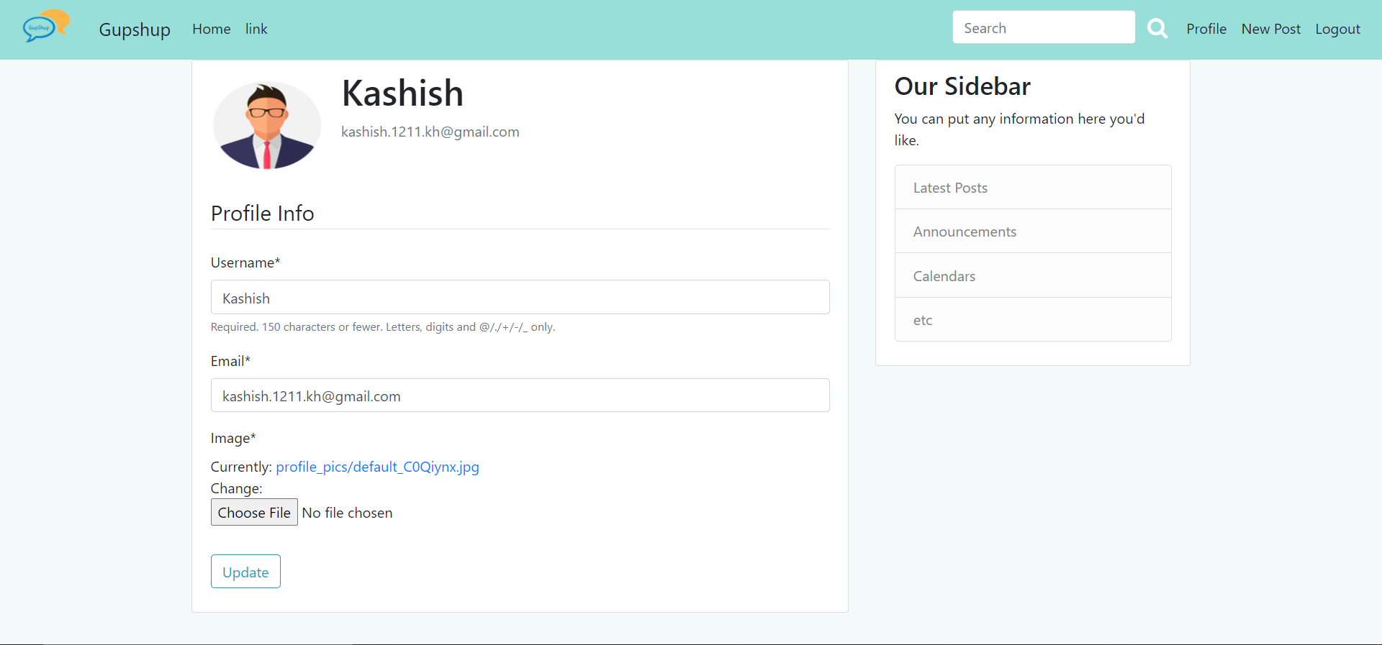
05. Profile

Slide 26
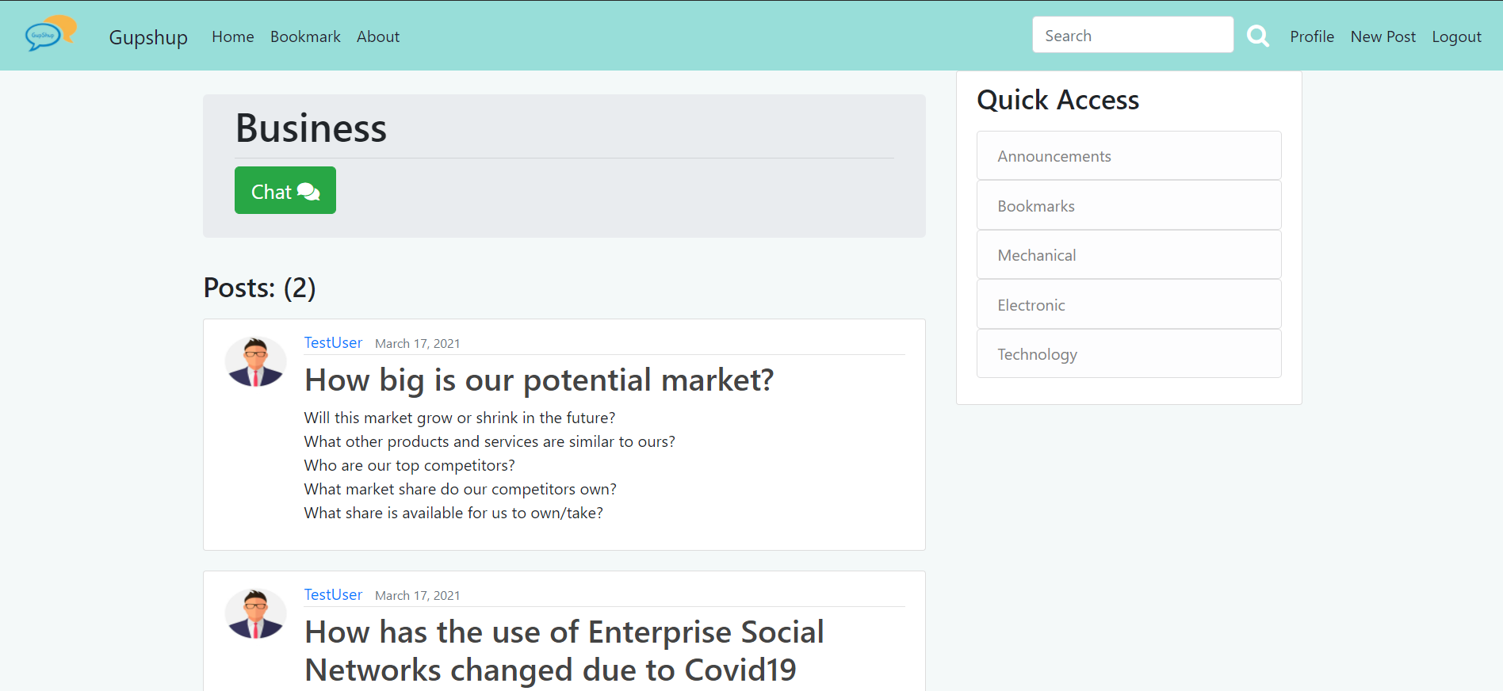
06. Category-wise Posts

Slide 27
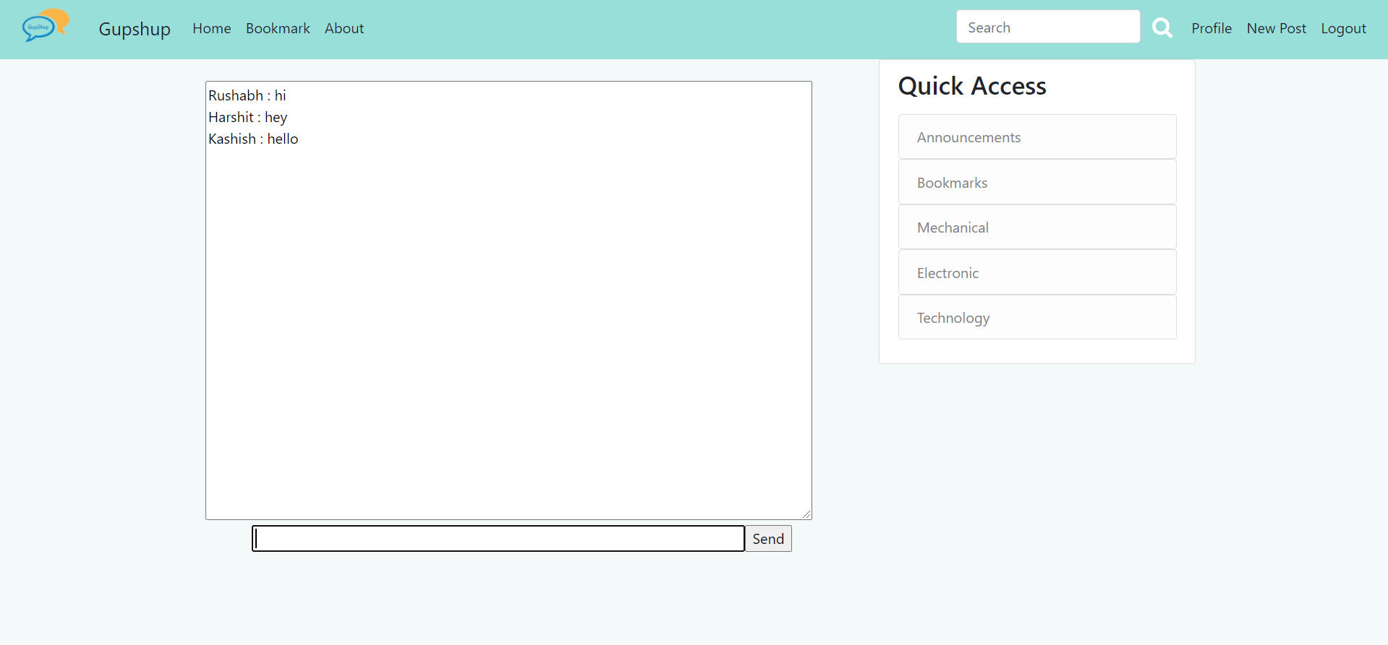
07.Chat

Slide 28
Future Scope
Trust rating of user
Private Chat
Recommendation System

Slide 29
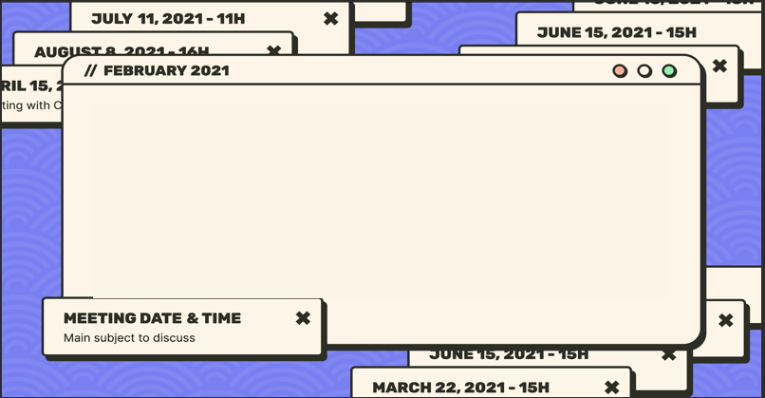

Github Link
https://github.com/kashish1211/GUPSHUP

Slide 30
References
https://docs.djangoproject.com/en/3.1/
https://getbootstrap.com/docs/4.0/getting-started/introduction/
https://developer.mozilla.org/en-US/docs/Web/JavaScript
https://tailwindcss.com/
https://stackoverflow.com/
https://www.geeksforgeeks.org/

Slide 31
THANK YOU!
Signing off
DO YOU HAVE ANY QUESTIONS?
youremail@freepik.com
+34 654 321 321
yourwebsite.com
Please keep this slide for attribution

